Slide 1
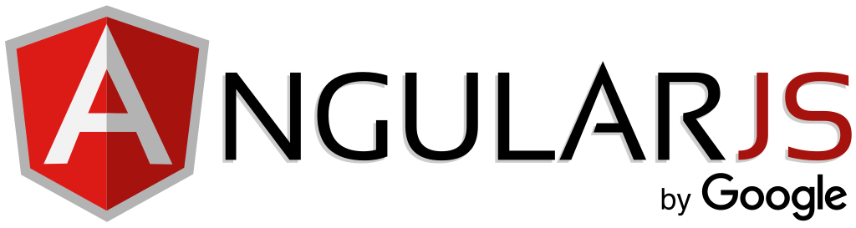
A Retrospective
OCI Tech Lunch
6/22/2018
Jason Schindler
schindlerj@objectcomputing.com

Slide 2
Some Background

Slide 3
AngularJS
Open-source JavaScript framework for creating Single-page applications (SPA)
Applications designed using a Model-View-ViewModel (MVVM) or Model-View-Controller (MVC) architecture.
Early successful framework for SPA applications.
Declarative definition of view. Imperative updates to model.
2-way data binding allows non-controller things to update model.

Slide 4
Single-Page Applications
After application initially loads, further loading is done in JavaScript without refreshing the page.
UI Logic executed on client browser instead of server.
Web applications start behaving more like desktop / mobile applications.
Smoother experience for end user.
Allows your web application to use the same service API as other applications.

Slide 5
Why A Retrospective?
New feature development on AngularJS (1.x) is stopping June 30th.
LTS will go until June 30, 2021.
At one time, AngularJS was THE framework to use for writing SPAs.
What did they get right? What could they have done better?
Without it, would we be where we are now?

Slide 6
Timeline

Slide 7
2006
August
jQuery 1.0 Released
  Cross-browser compatible
  Simplified DOM element selection and manipulation
  Improved Event Listening / Handling
  Improved “Ajax” HTTP requests

Slide 8
2010
July
Knockout.js Initial Release
October
AngularJS 0.9.0 Released
  First release on GitHub
  Included “jqLite”
November
Express.js Initial Release

Slide 9
2011
March
First commits in “Traceur” repository
May
ES6 (ECMAScript 2015) “Proposal Freeze”
December
Ember.js Initial Release

Slide 10
2012
January
Initial Release of SlimJim (Later: Testacular) (Later: Karma)
Initial Release of Grunt
March
Initial Release of Webpack
June
AngularJS 1.0.0 Released

Slide 11
2012
July
Batarang Chrome Extension Announced
September
Initial Release of Bower
AngularJS 1.1.0 Released

Slide 12
AngularJS 1.0.0 / 1.1.0
Considered “Experimental”
Very Compelling “Hello World” Example
Included most base concepts of the framework
  Services
  Templates
  Controllers
  Directives
  Filters
  $scope
  $injector
  $http
Included mock objects for most framework items for easier testing

Slide 13
The “Angular Way”
Early on, new users would often use jQuery to do “simple stuff” and would get frustrated when the application didn’t update correctly.
Usually occurred because bound data was being updated outside of the Angular “digest” cycle.
Set a precedent that operating outside of the framework was de-facto wrong.
I believe this is one of the reasons that the current Angular framework is as prescriptive as it is.

Slide 14
:)
Brought an architecture and maturity to JavaScript SPAs
$scope is a clever solution to problem of distributed state in a web application
Testing support and debugging browser extensions
“Hello World” Made adoption look simple

Slide 15
:(
A lot of concepts to understand at once
2-way data binding required constant dirty checking of all bound data = potential for poor performance
“Angular Way” set a informal precedent that there was a “right” and “wrong” way to write applications in AngularJS.

